Slide 1
Trackeo
Verified Results. Real Opportunities. Connected Athletes. Juan Barrera

Slide 2

The Problem

Slide 3
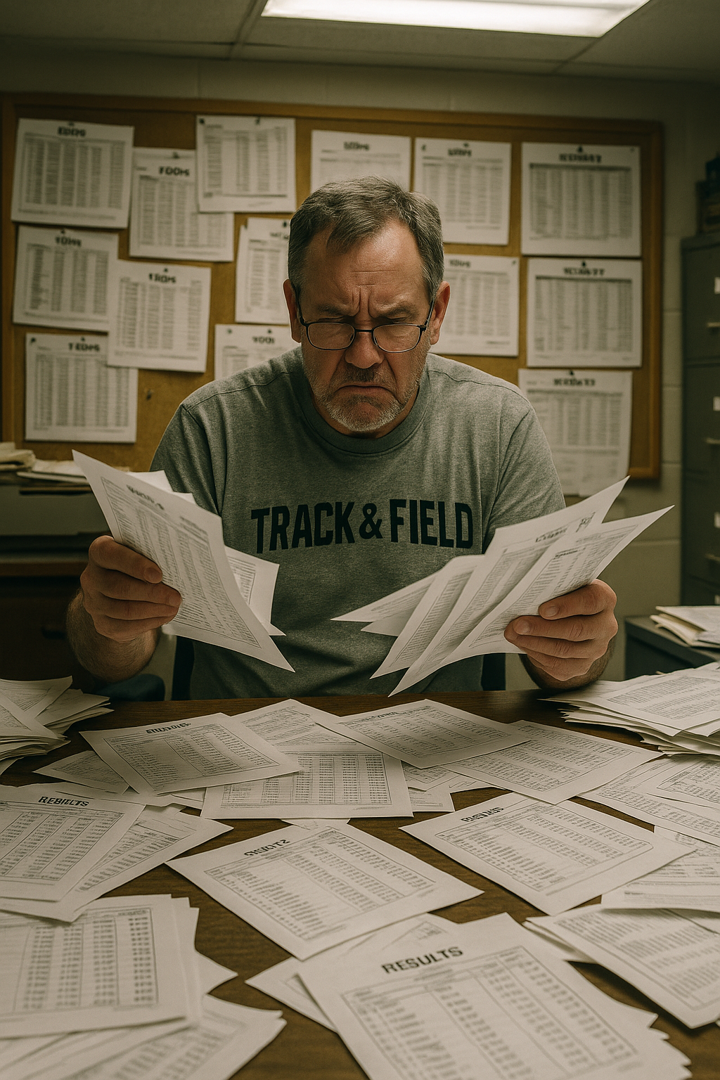
Fragmented and unreliable result tracking

Slide 4
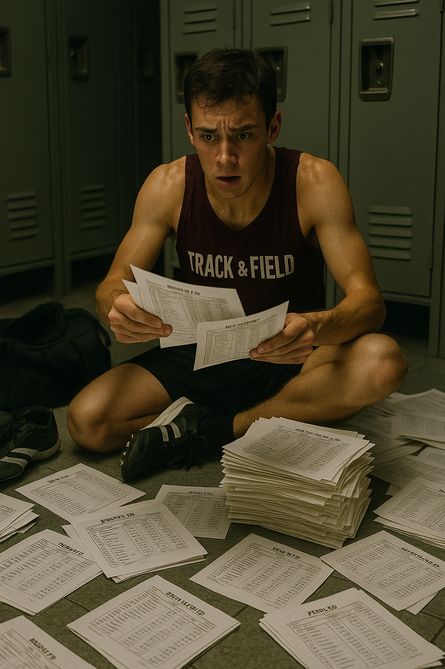
Limited access to recruiters and sponsors

Slide 5

Lack of community and networking tools

Slide 6
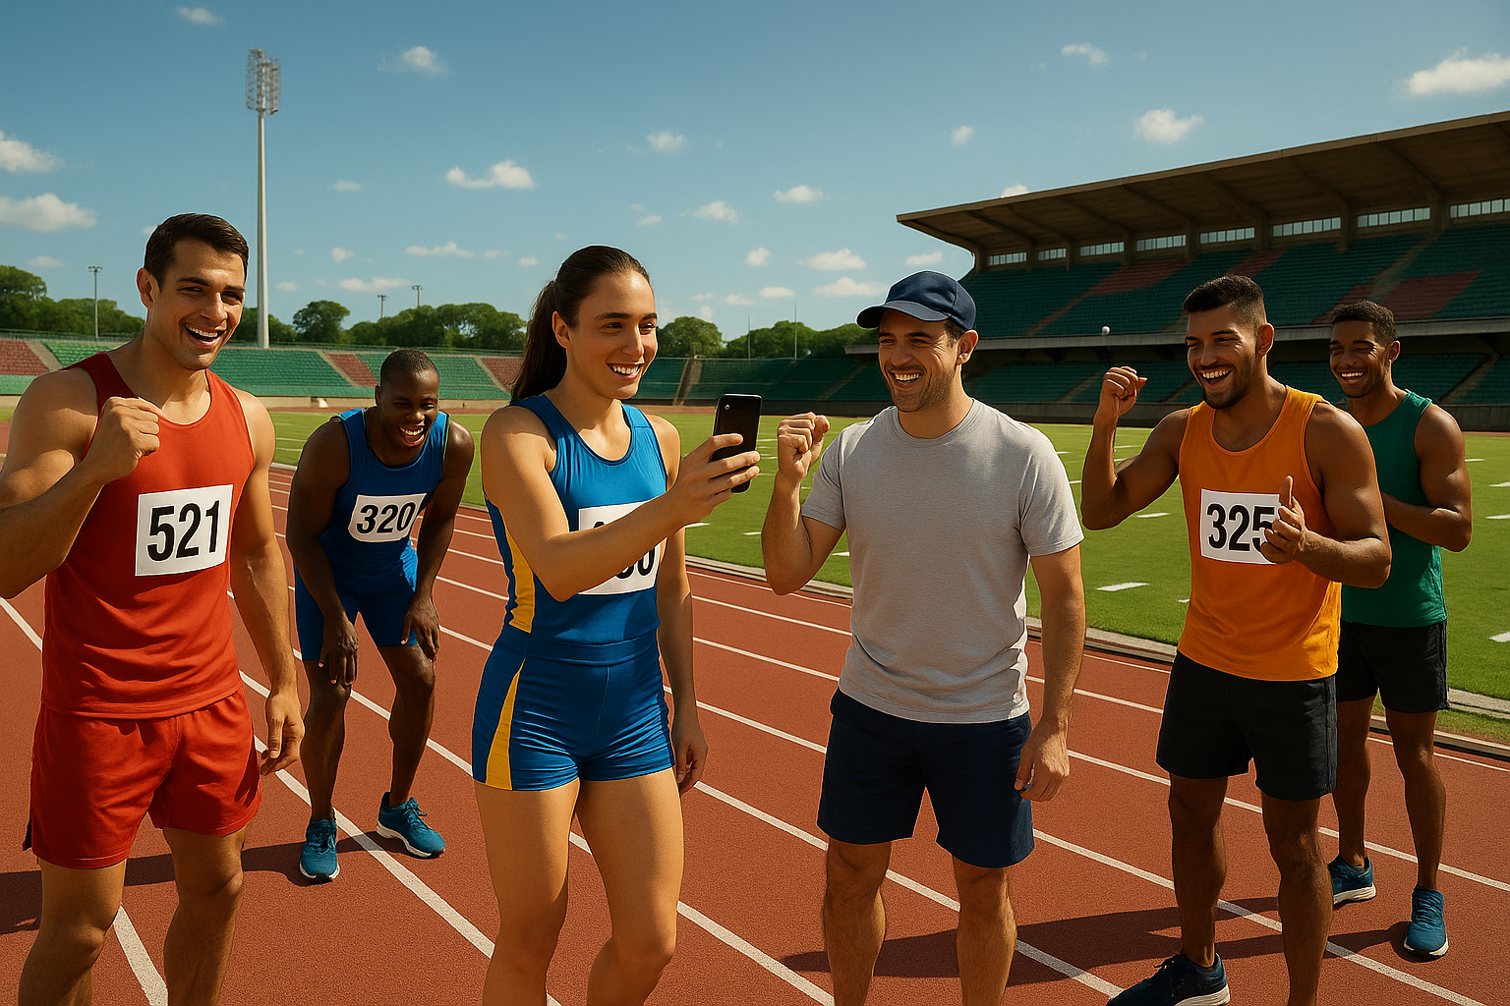
The Solution

Slide 7
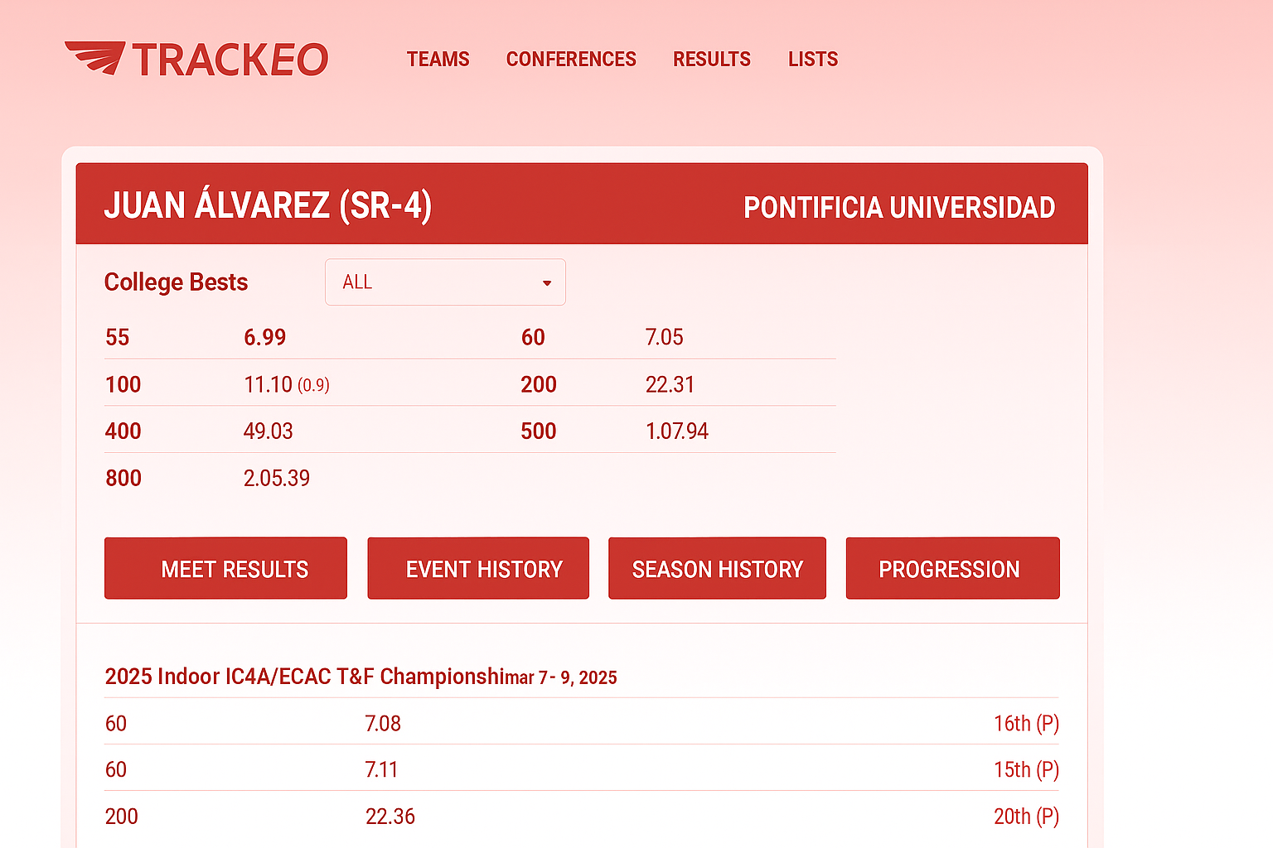
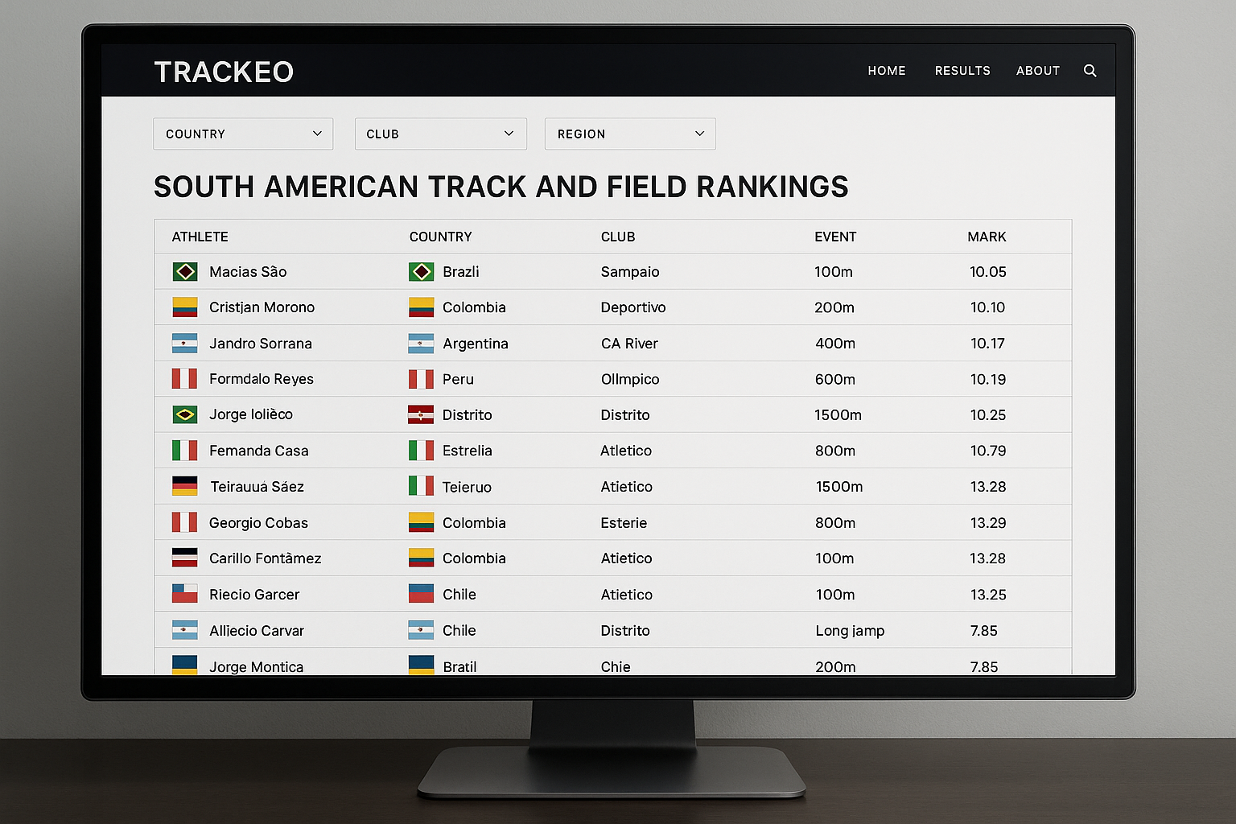
Verified athlete profiles & performance history

Slide 8
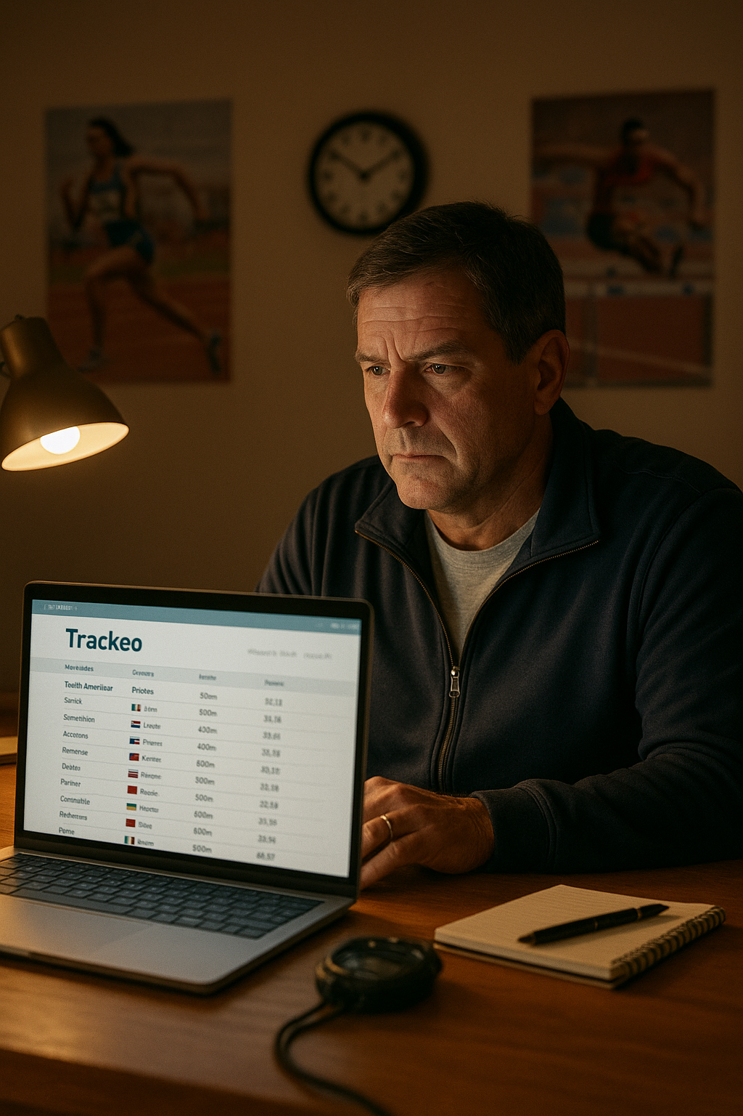
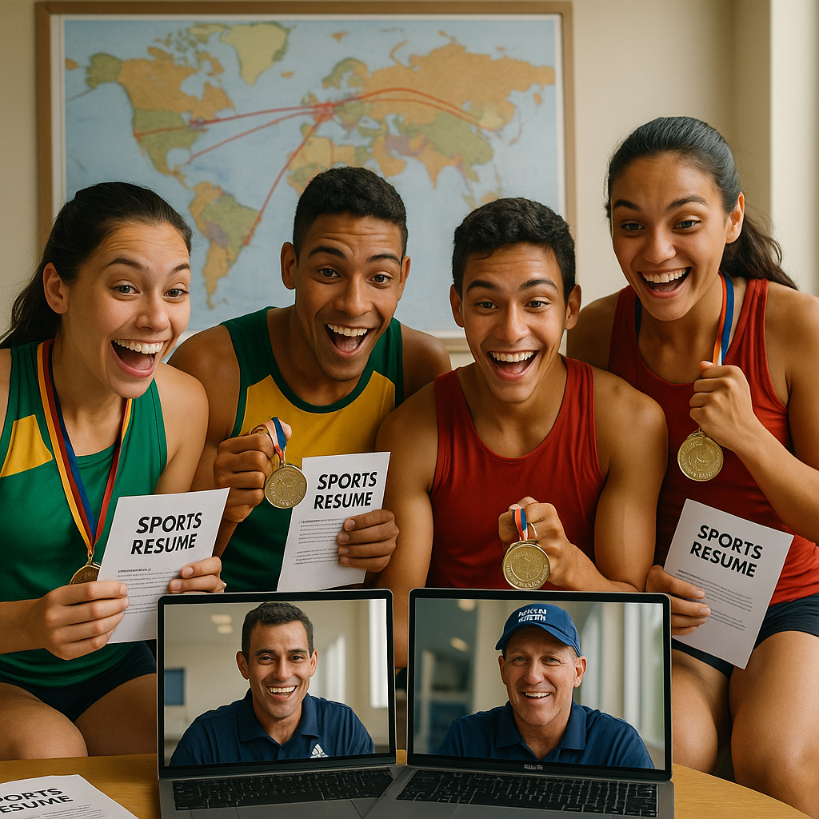
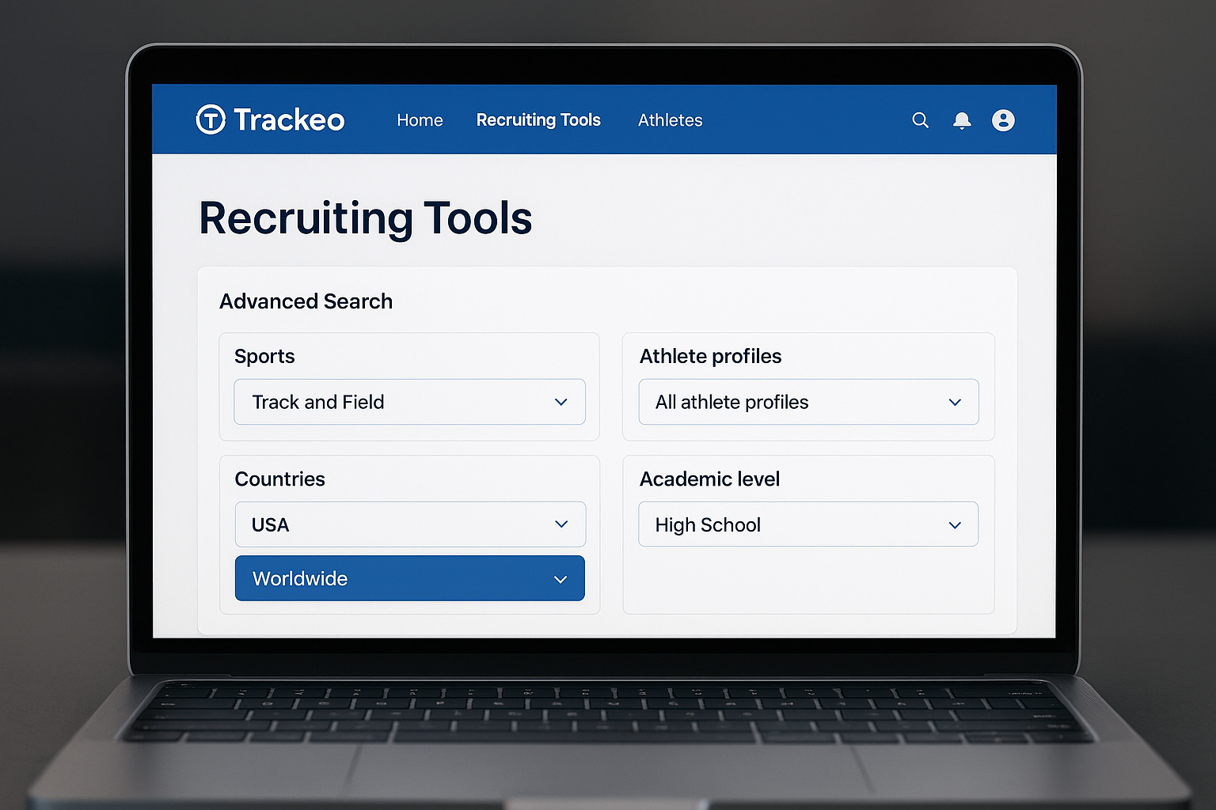
Recruiting tools & scholarship resources with advanced filters

Slide 9
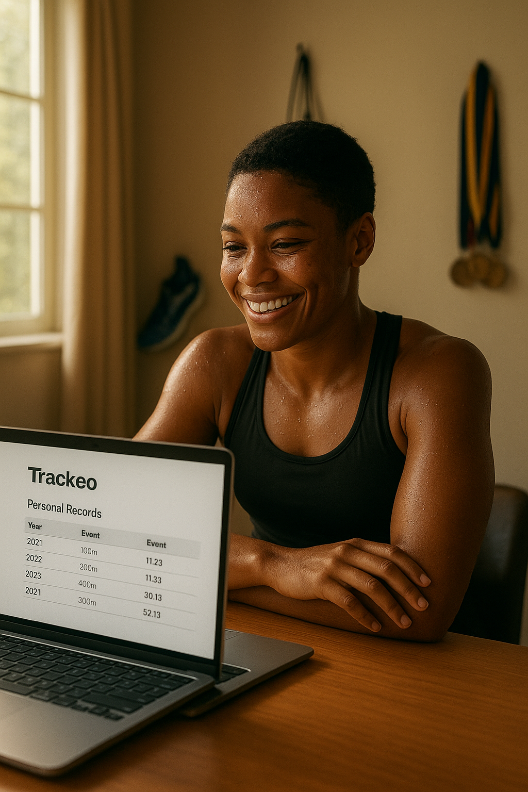
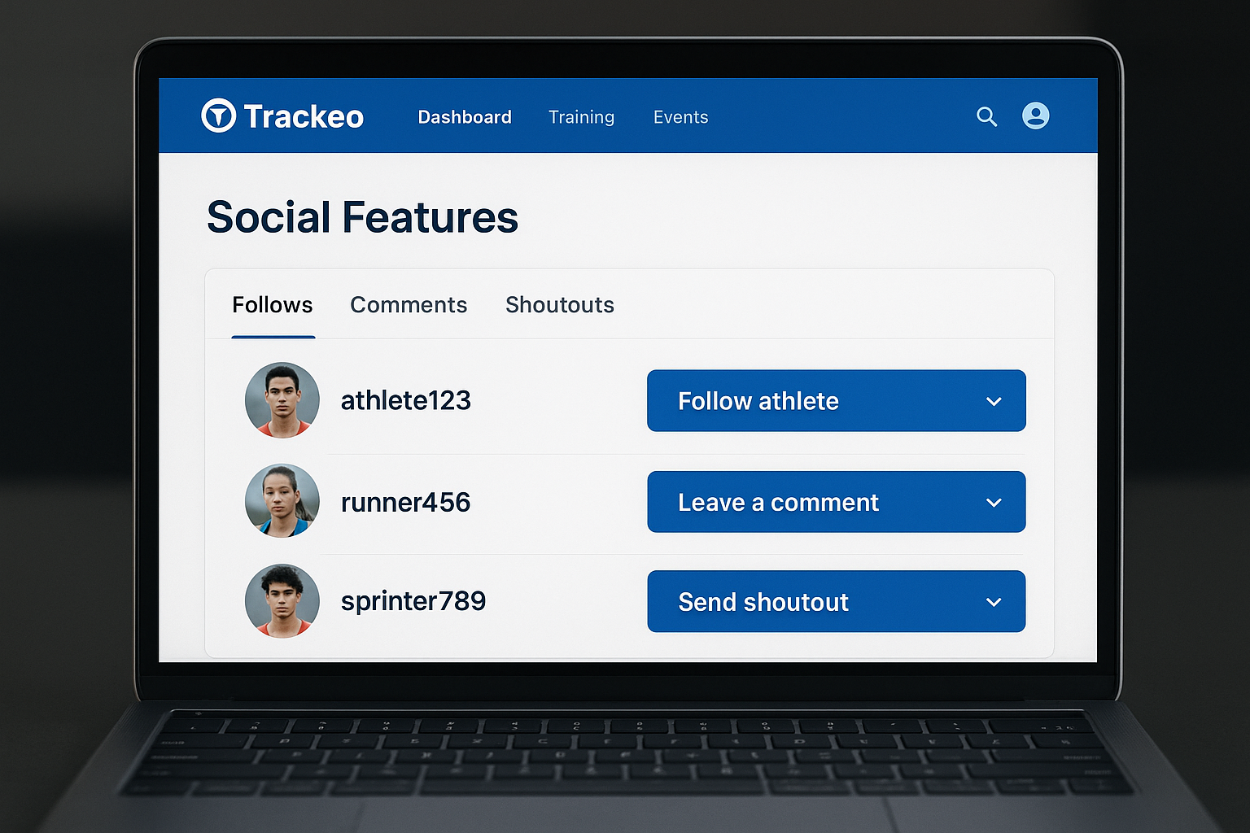
Social features: follows, comments, shoutouts

Slide 10
Target Audience
Primary: Athletes, Coaches, Clubs
Secondary: Investors & Recruiters
Need: Verified performance data & streamlined networking & working along national sports federations

Slide 11
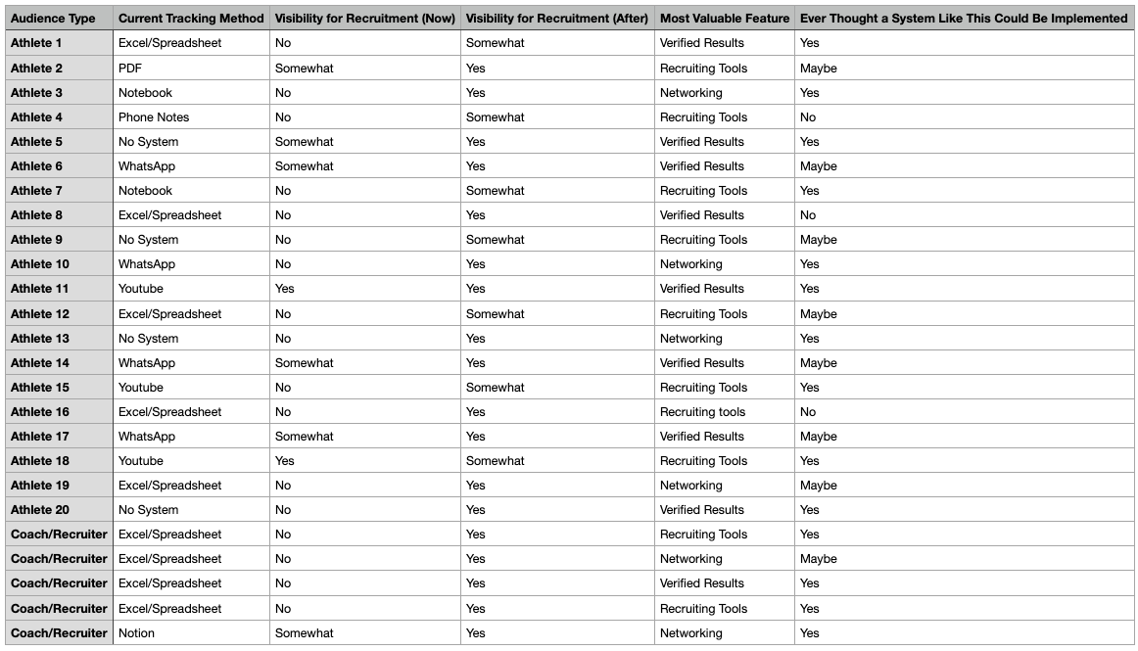
Validation & Insights (Before explaining Trackeo)

Slide 12
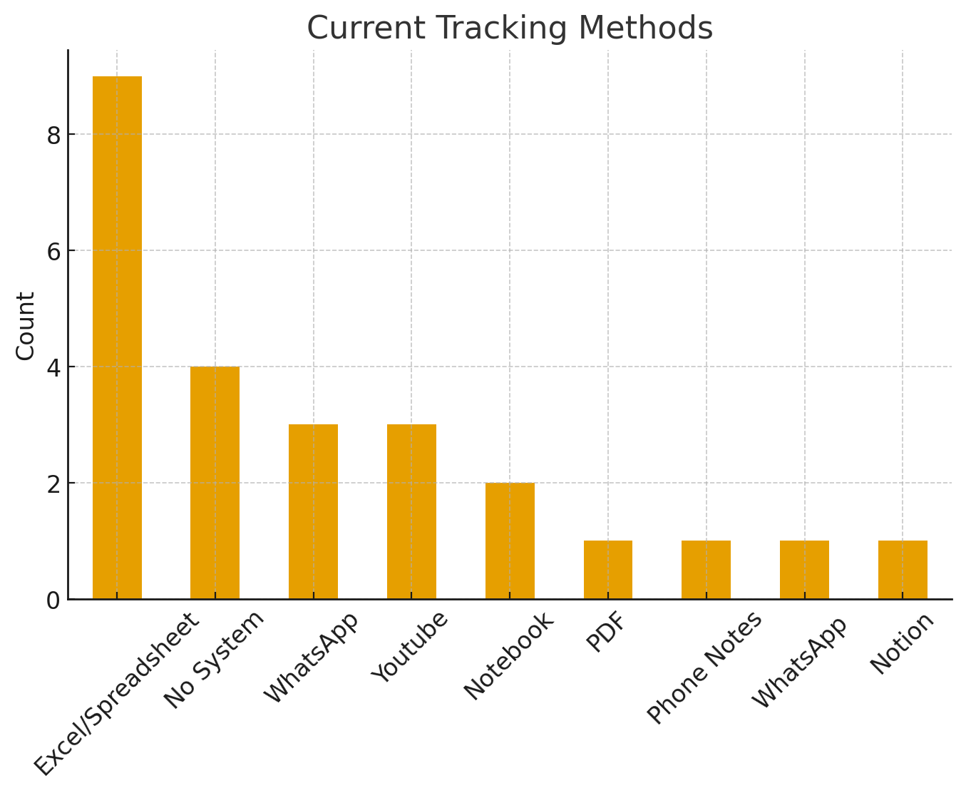

Slide 13
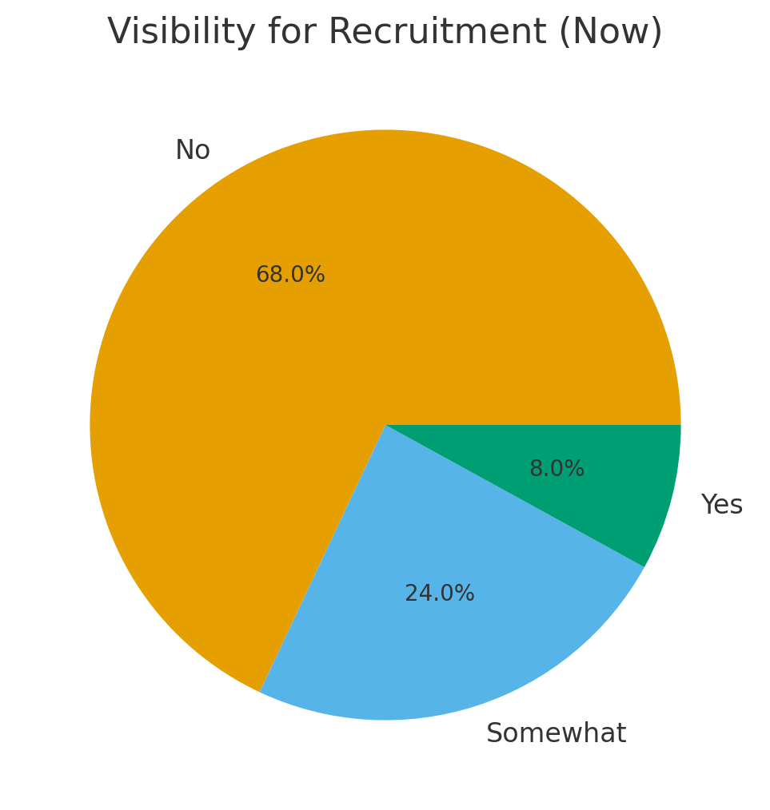

Slide 14
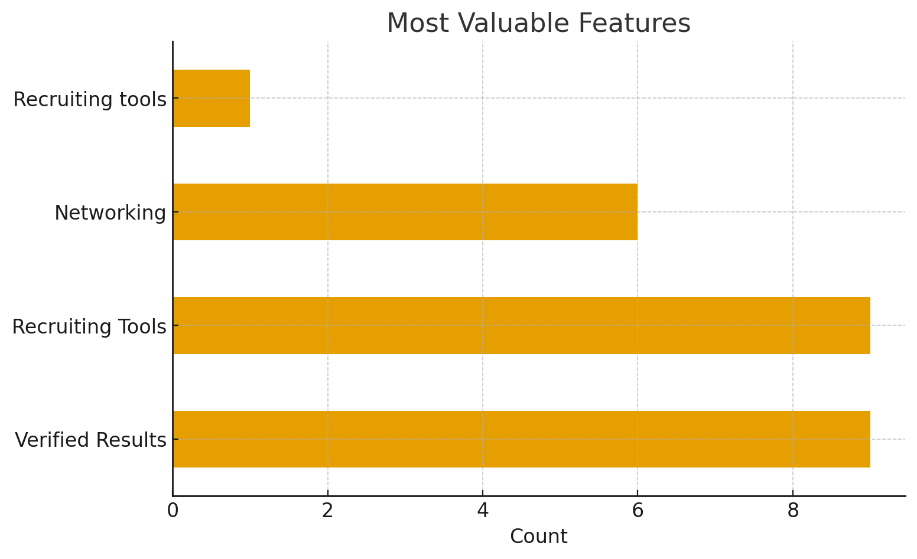

Slide 15
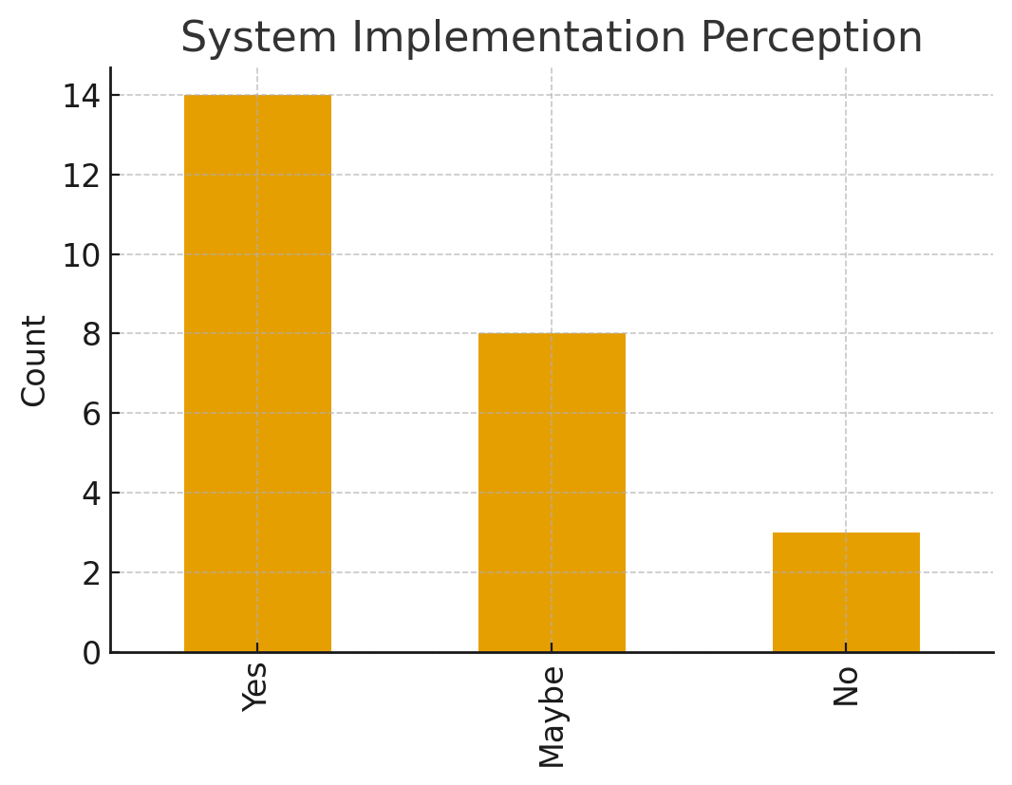

Slide 16
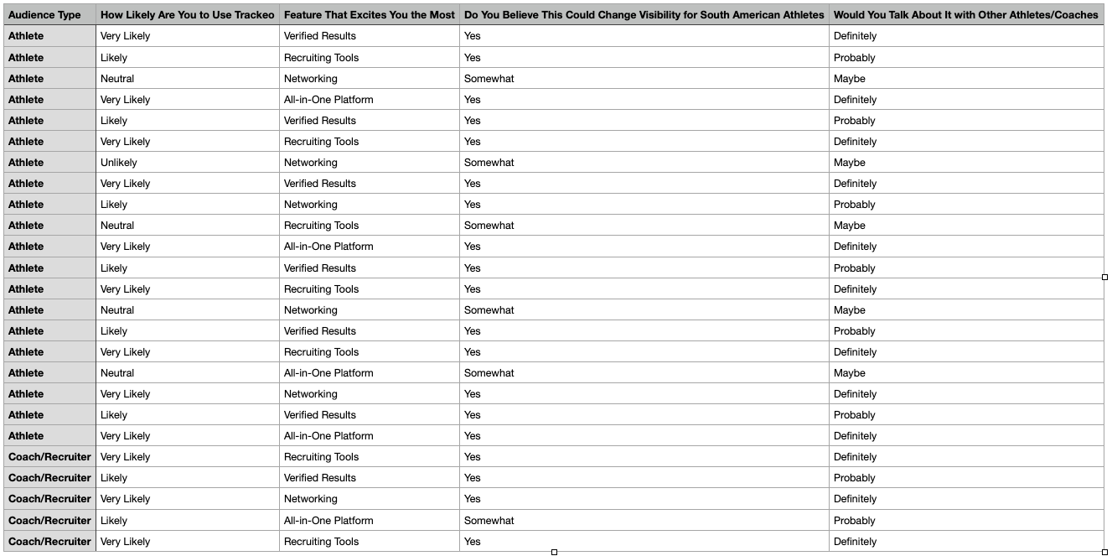
Validation & Insights (After explaining Trackeo)

Slide 17
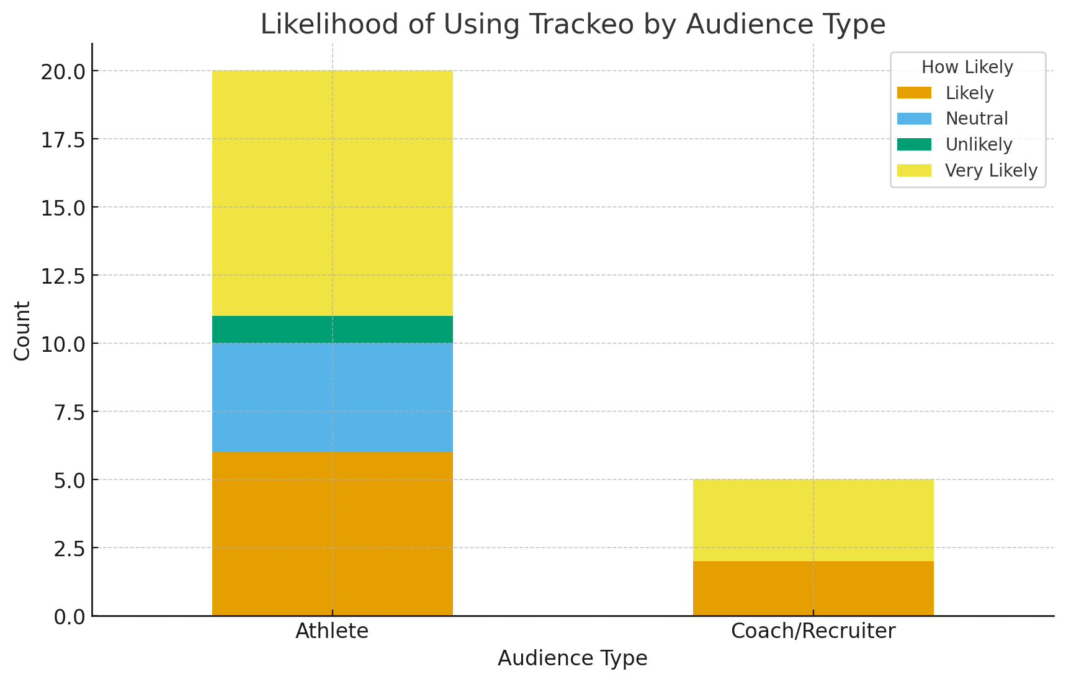

Slide 18
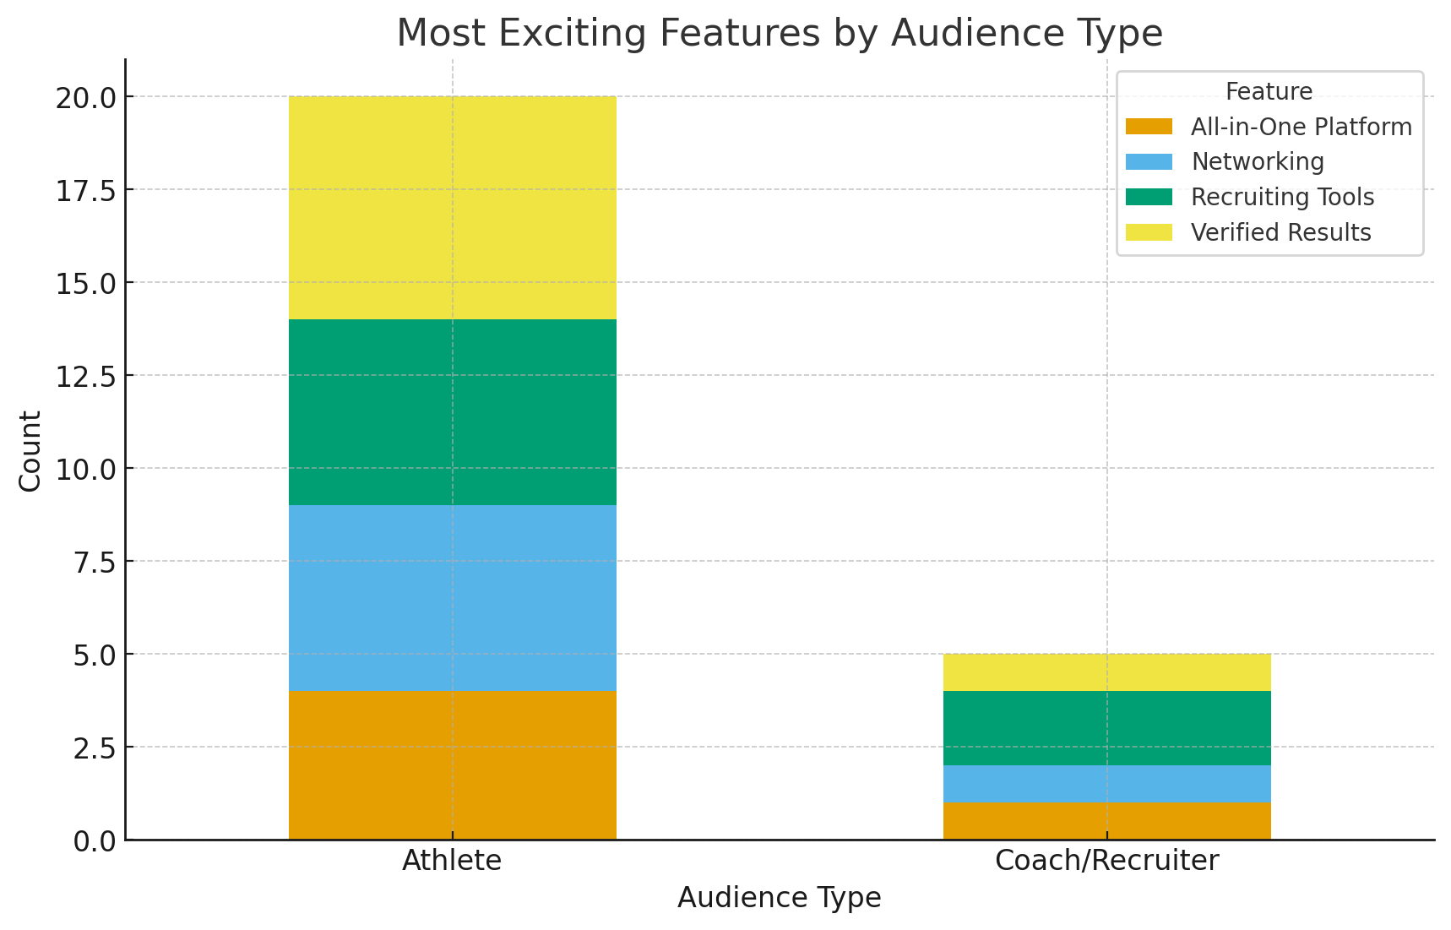

Slide 19
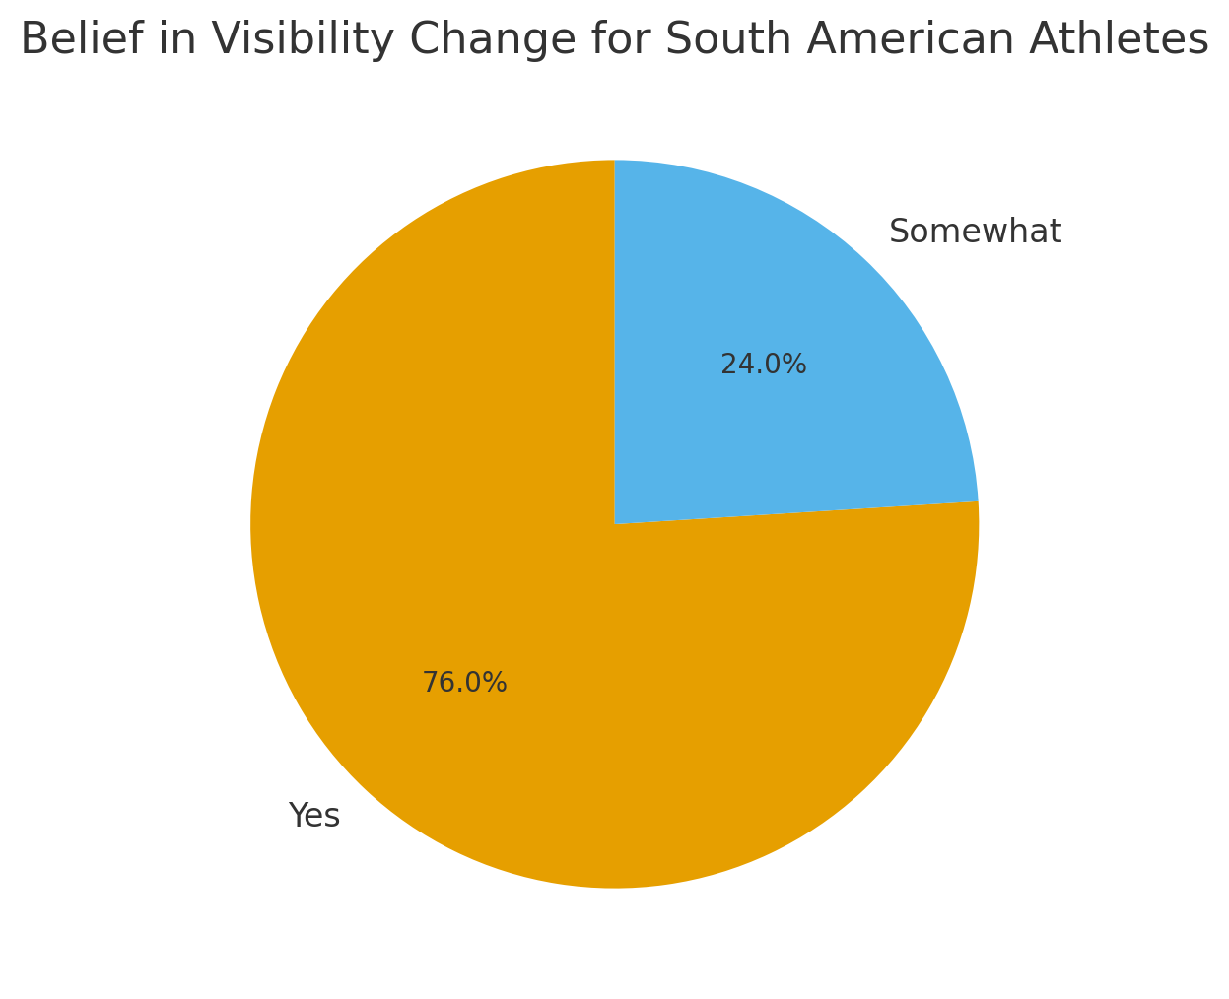

Slide 20
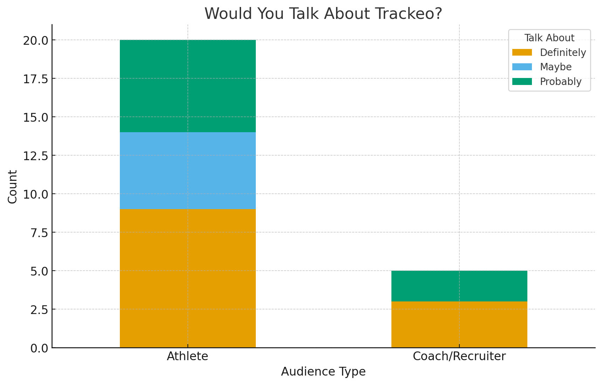

Slide 21
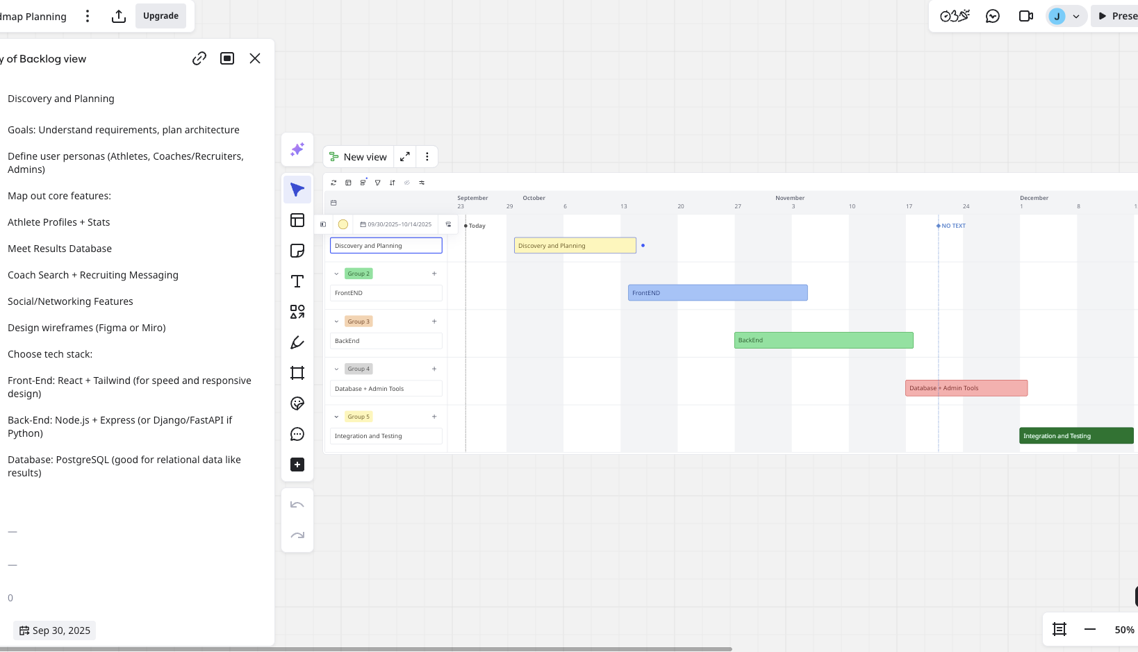
Miro

Slide 22
Why Now?
South America is a fast-growing athletic region
High demand for transparent results in digital sports
No major competitor combining verified data + networking

Slide 23
Why Trackeo Deserves Funding
South American athletes currently lack a centralized, verified platform for tracking results and showcasing themselves to recruiters. This limits their opportunities to secure scholarships or professional contracts abroad.
Trackeo is the first platform designed specifically to combine:
Verified Results Database (like TFRRS but focused on South America)
Recruiting Tools (coaches can message athletes directly)
Networking Features (athletes can connect, follow, and share progress)
This combination not only solves the visibility issue but also creates a professional ecosystem for athletes, coaches, and recruiters.
Funding will allow us to:
Scale the platform to handle all South American results
Build a mobile version to reach more athletes
Market the app to universities and professional teams worldwide

Slide 24
Insights & Data Analysis
Pre-Survey Insight:
85% athletes used manual tracking (spreadsheets or Somewhere they manually added results)
75% felt they were invisible to recruiters
Post-Survey Insight:
Likelihood to use Trackeo: 80%
Most Exciting Feature: Verified Results + Recruiting
Belief in Impact: 76% said it will change South American visibility
Word-of-Mouth Potential: 80%+ would share with others
This shows clear market validation, athletes and coaches not only like the idea but want to use it and promote it.

Slide 25
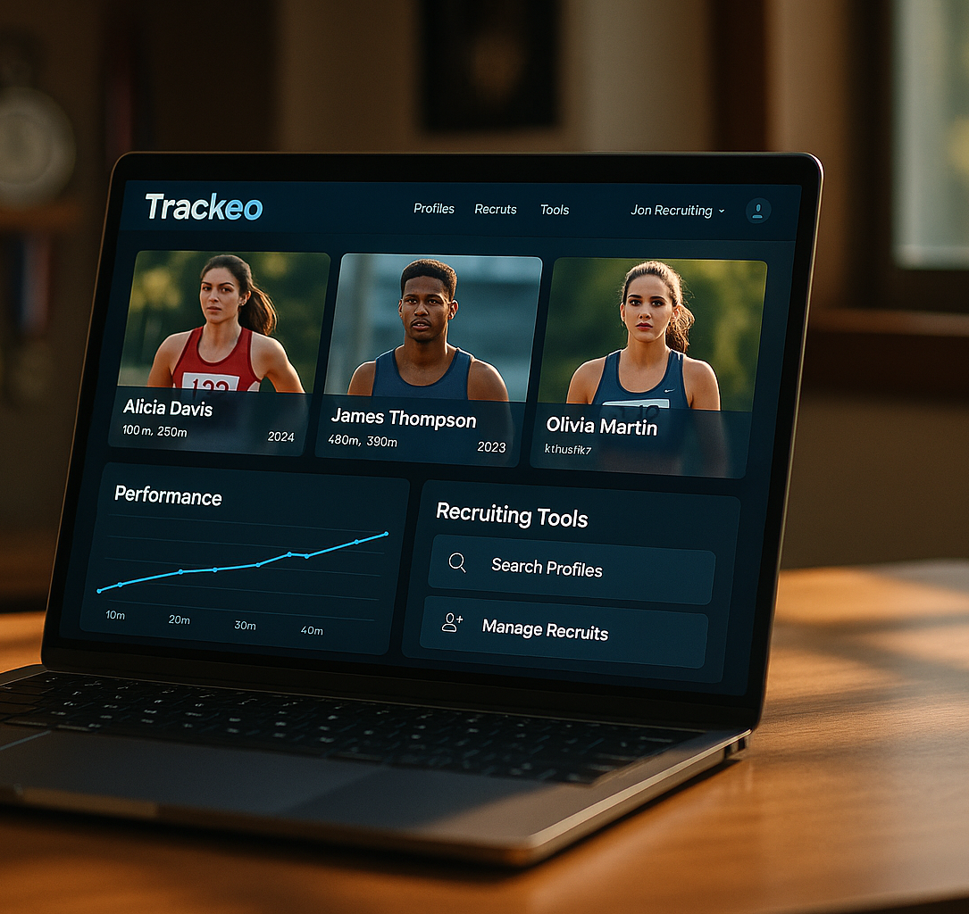
Thank You!

